Slide 1
COMPUTER GRAPHICS AND MULTIMEDIA
CS3CO24

Slide 2
UNIT 5
Multimedia: Characteristics of a Multimedia Presentation, Multimedia Architecture, Text –Types, Unicode Standard, Text File Formats,
Audio- Components of an Audio System, Digital Audio, Digital Audio Processing, Audio File Formats, Video- Digital Video, Digital Video Processing, Video File Formats.
Animation: Uses of Animation, Principles of Animation, 3D Animation, Animation File Formats, Animation Software, MPEG Standards.

Slide 3
What is Multimedia?
Derived from the word “Multi” and “Media”
Multi
Many, Multiple,
Media
Distribution tool & information presentation – text, graphic, voice, images, music and etc.

Slide 4
Definition of Multimedia
Multimedia is a combination of text, graphic, sound, animation, and video that is delivered interactively to the user by electronic or digitally manipulated means.

Slide 5
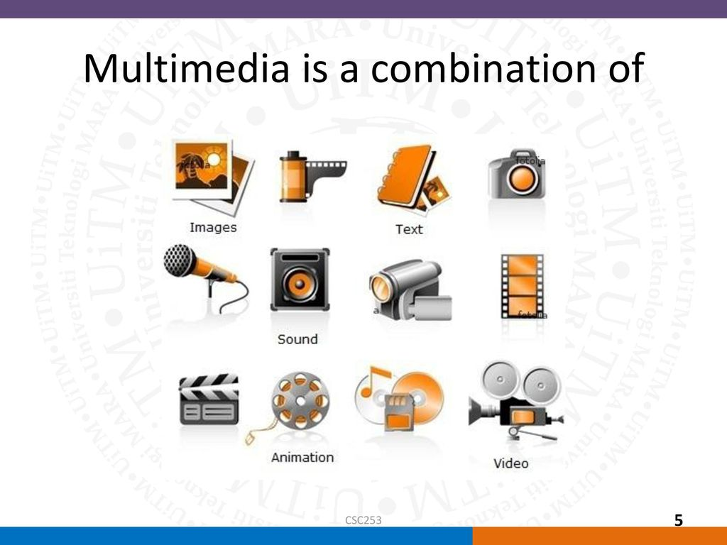

Slide 6
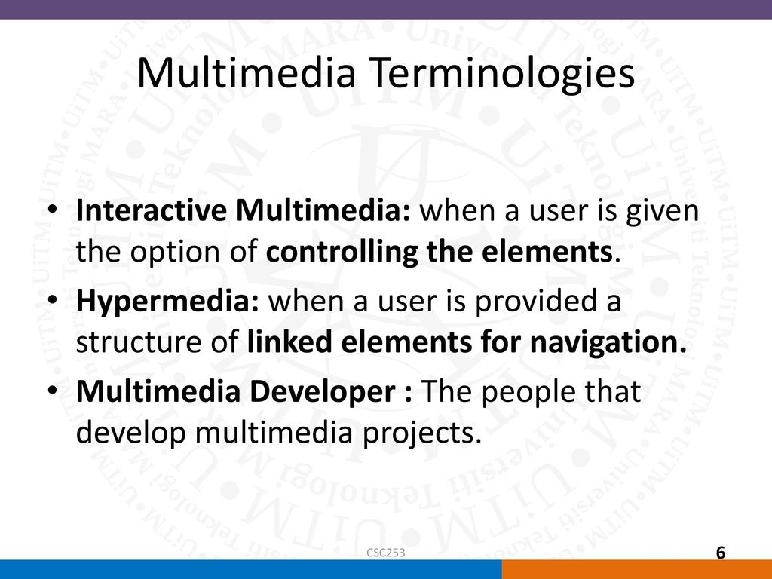

Slide 7
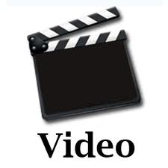
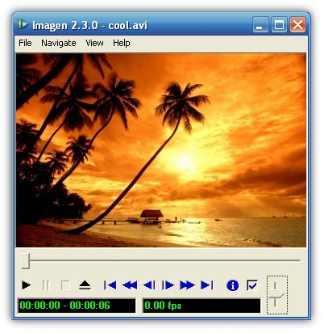
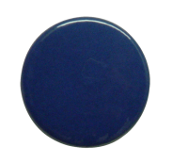
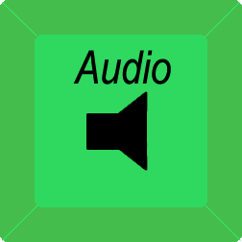

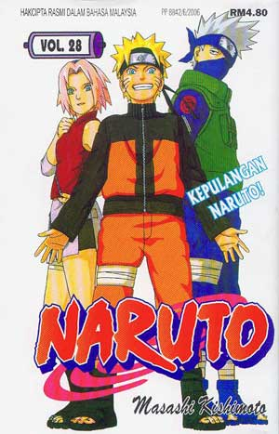
Example
Hyper Text and Hyper Media
Main Page
Video link
Image link
Audio Link

Slide 8
Elements of Multimedia
There are 5 elements
Text
Graphic
Audio
Animation
Video

Slide 9
5 Elements of Multimedia
TEXT
GRAPHIC
TEXT
MULTIMEDIA
AUDIO
VIDEO
ANIMATION
A broad term for something that contains words to express something.
Text is the most basic element of multimedia.
A good choice of words could help convey the intended message to the users (keywords).
Used in contents, menus, navigational buttons

Slide 10
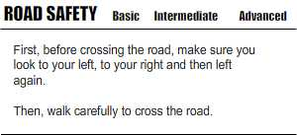
5 Elements of Multimedia
TEXT
GRAPHIC
TEXT
MULTIMEDIA
AUDIO
VIDEO
ANIMATION
Example

Slide 11
5 Elements of Multimedia
TEXT
GRAPHIC
GRAPHIC
MULTIMEDIA
AUDIO
VIDEO
ANIMATION
Two-dimensional figure or illustration
Could be produced manually (by drawing, painting, carving, etc.) or by computer graphics technology.
Used in multimedia to show more clearly what a particular information is all about (diagrams, picture).

Slide 12
5 Elements of Multimedia
TEXT
GRAPHIC
GRAPHIC
MULTIMEDIA
AUDIO
VIDEO
ANIMATION
A Picture means a thousand words

Slide 13
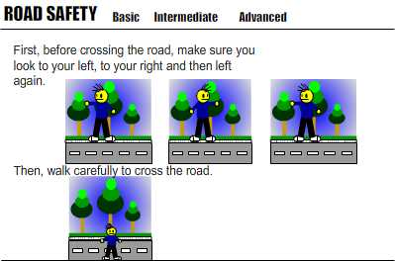
5 Elements of Multimedia
TEXT
GRAPHIC
GRAPHIC
MULTIMEDIA
AUDIO
VIDEO
ANIMATION
Example

Slide 14
5 Elements of Multimedia
TEXT
GRAPHIC
AUDIO
MULTIMEDIA
AUDIO
VIDEO
ANIMATION
Produced by vibration, as perceived by the sense of hearing.
In multimedia, audio could come in the form of speech, sound effects and also music score.

Slide 15
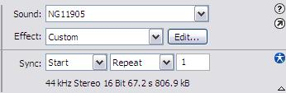
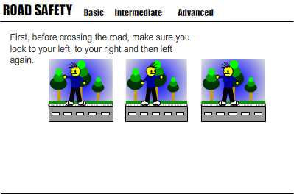
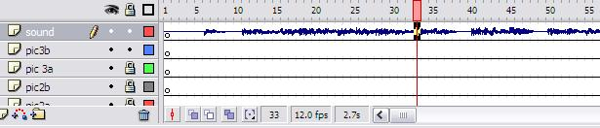
5 Elements of Multimedia
TEXT
GRAPHIC
AUDIO
MULTIMEDIA
AUDIO
VIDEO
ANIMATION
Example

Slide 16
5 Elements of Multimedia
TEXT
GRAPHIC
ANIMATION
MULTIMEDIA
AUDIO
VIDEO
ANIMATION
The illusion of motion created by the consecutive display of images of static elements.
In multimedia, animation is used to further enhance / enriched the experience of the user to further understand the information conveyed to them.

Slide 17
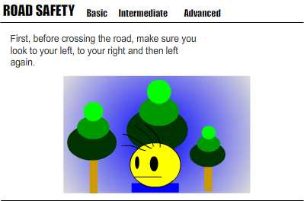
5 Elements of Multimedia
TEXT
GRAPHIC
ANIMATION
MULTIMEDIA
AUDIO
VIDEO
ANIMATION
Example

Slide 18
5 Elements of Multimedia
TEXT
GRAPHIC
VIDEO
MULTIMEDIA
AUDIO
VIDEO
ANIMATION
Is the technology of capturing, recording, processing, transmitting, and reconstructing moving pictures.
Video is more towards photo realistic image sequence / live recording as in comparison to animation.

Slide 19
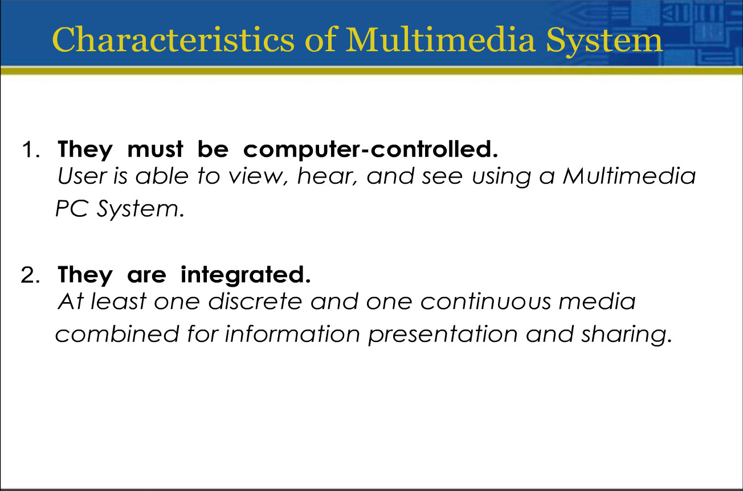

Slide 20
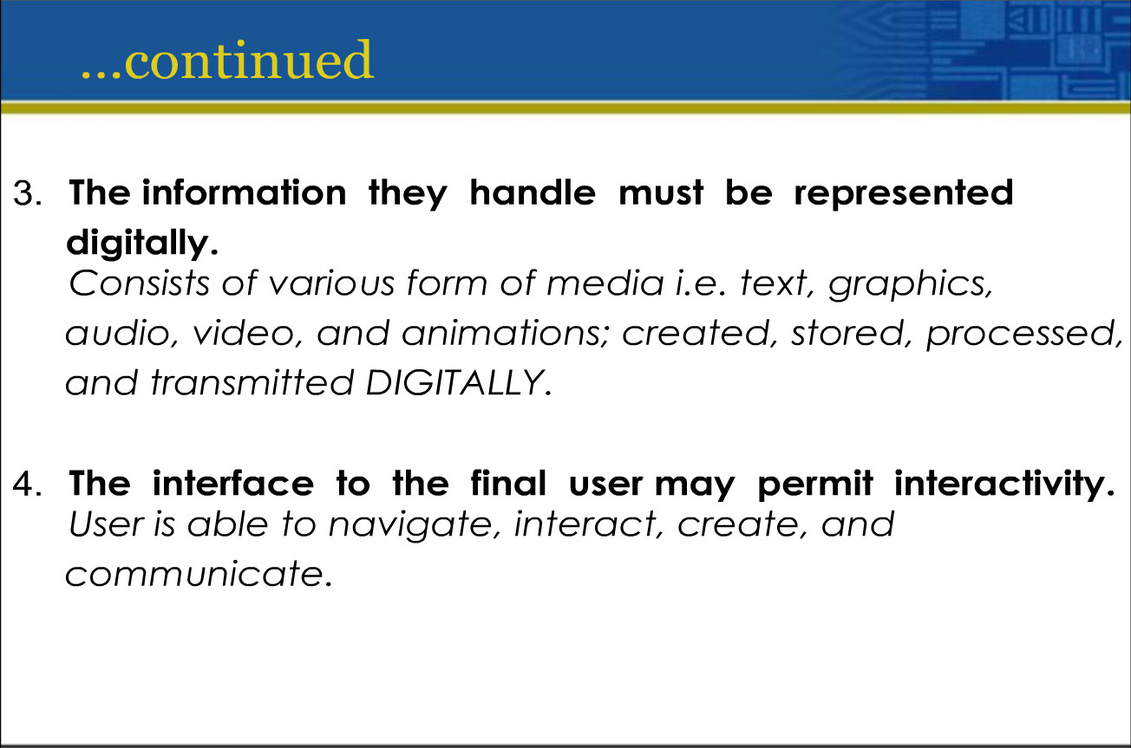

Slide 21
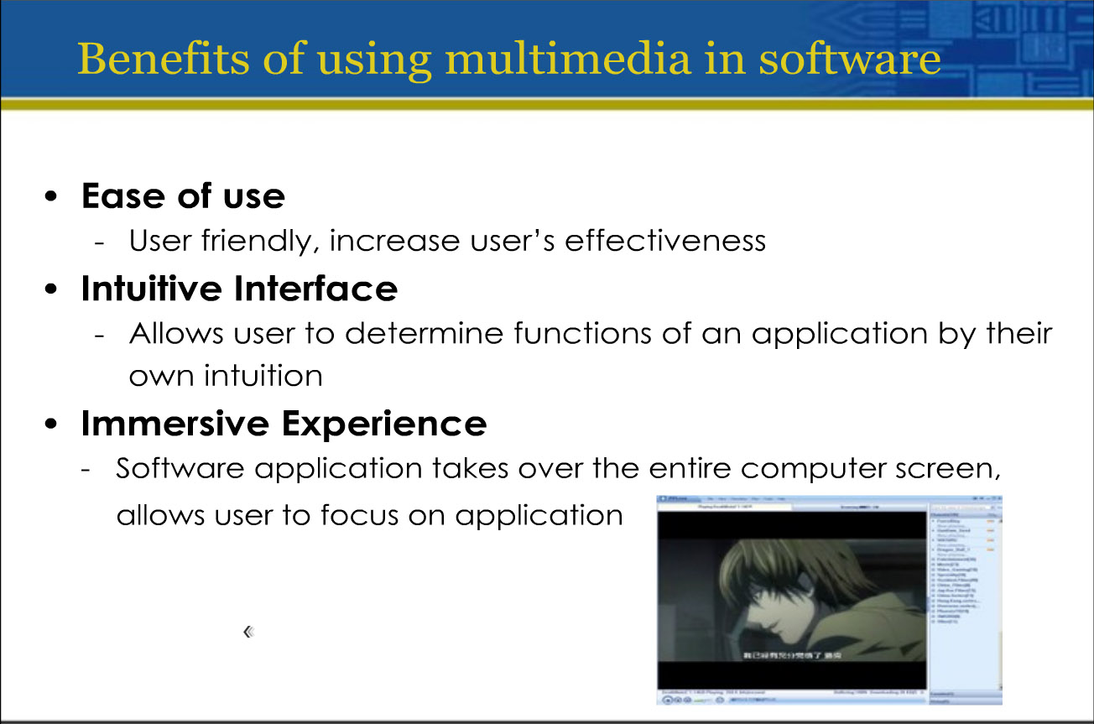

Slide 22
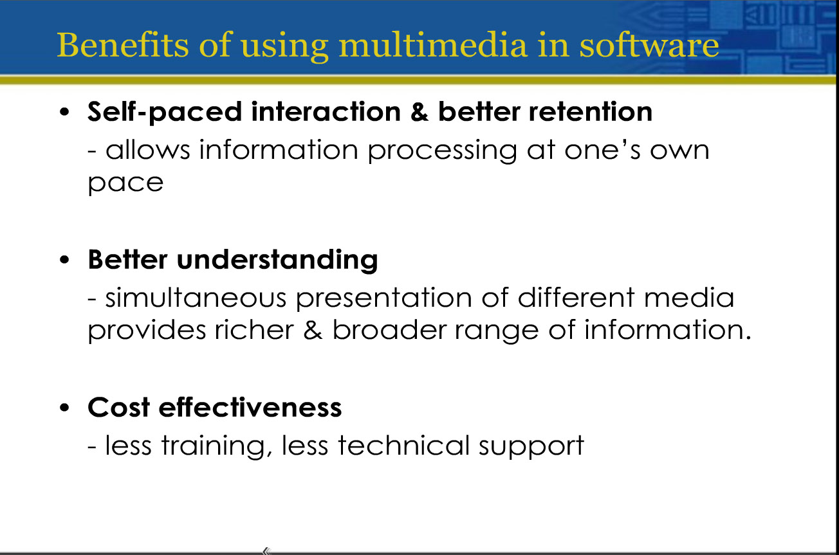

Slide 23
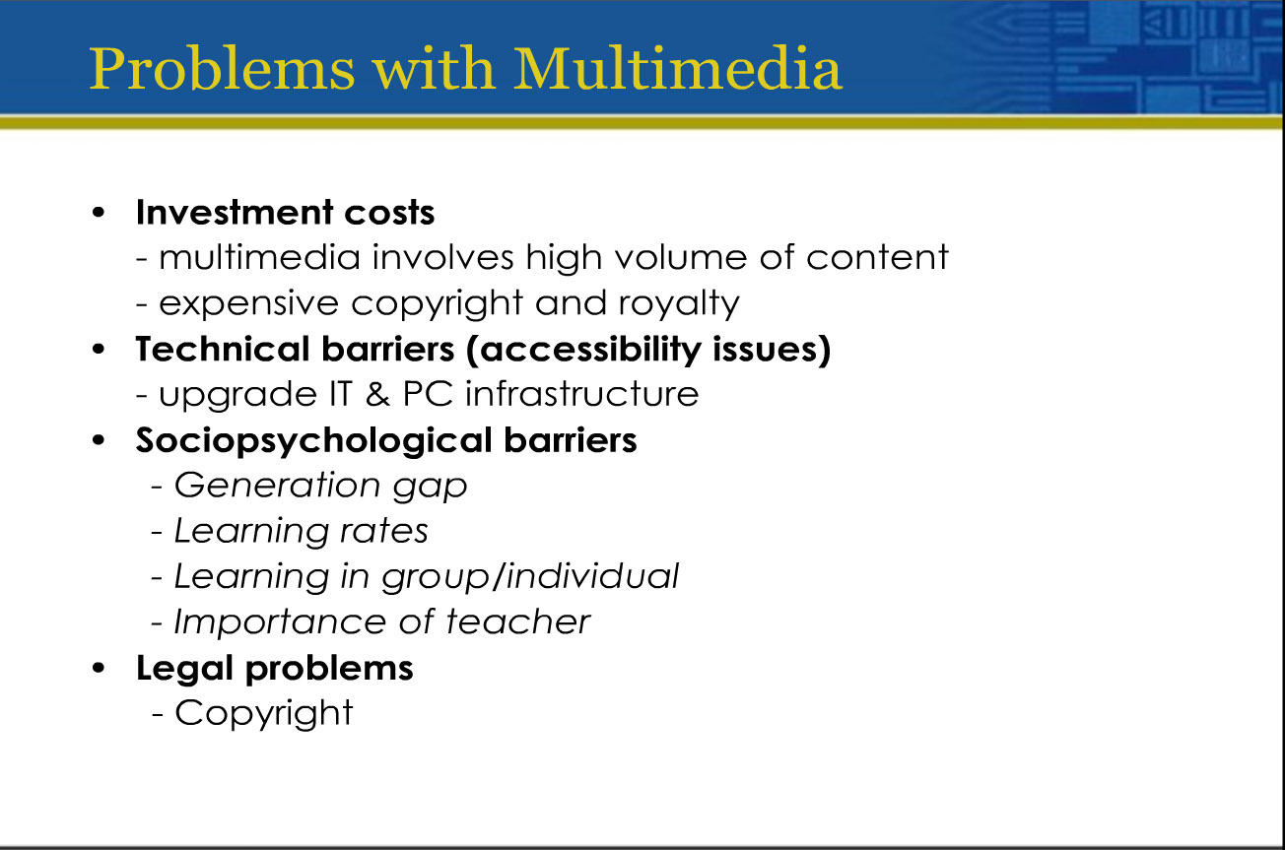

Slide 24
Types of multimedia
Linear Multimedia
Non Linear Multimedia

Slide 25
Types of multimedia
LINEAR
A Multimedia Project is identified as Linear when:
It is not interactive
User have no control over the content that is being showed to them.
Example:
A movie
A non-interactive lecture / demo show

Slide 26
Types of multimedia
NON-LINEAR
A Multimedia Project is identified as Non-Linear when:
It is interactive
Users have control over the content that is being showed to them.
Users are given navigational control
Example:
Games
Courseware
Interactive CD

Slide 27
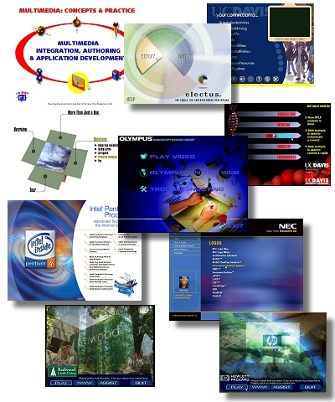
Importance of Multimedia
There are a number of fields where multimedia could be of use. Examples are:-
Business
Education
Entertainment
Home
Public Places

Slide 28
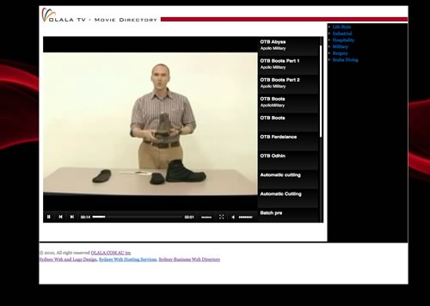
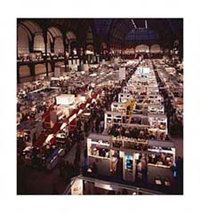
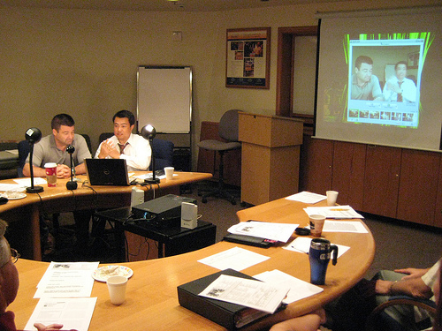

Importance of Multimedia
Business
Use and Applications
Sales / Marketing Presentation
Trade show production
Staff Training Application
Company Kiosk

Slide 29
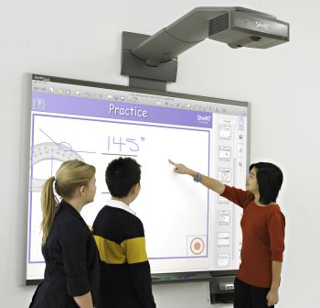
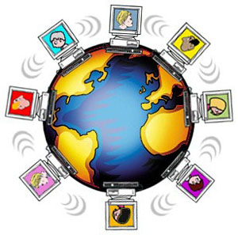

Importance of Multimedia
Education
Use and Applications
Courseware / Simulations
E-Learning / Distance Learning
Information Searching

Slide 30

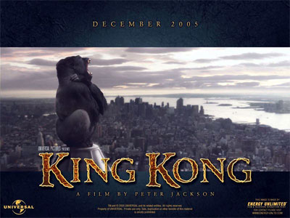
Importance of Multimedia
Entertainment
Use and Applications
Games (Leisure / Educational)
Movies
Video on Demand
Online

Slide 31
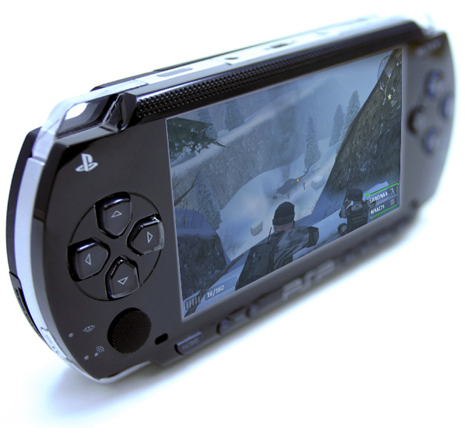


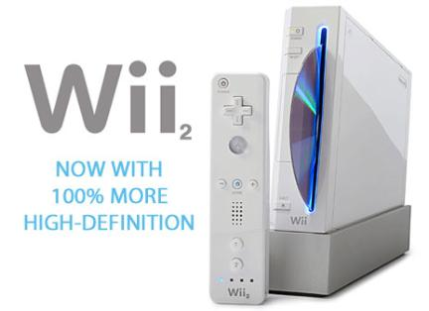

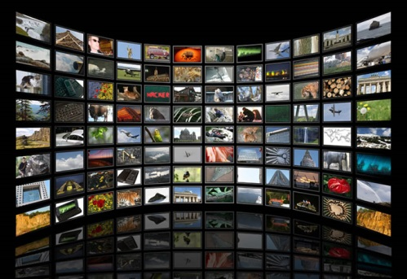
Importance of Multimedia
Home
Use and Applications
IPTV
Satellite TV
Games

Slide 32
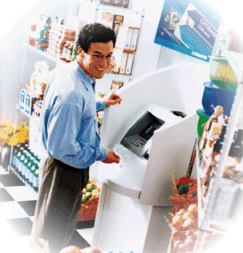

Importance of Multimedia
Public Places
Use and Applications
Information Kiosk
Smart Cards, Security

Slide 33
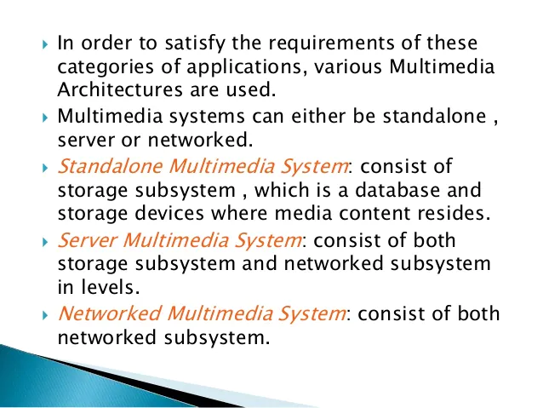
Multimedia Architecture

Slide 34
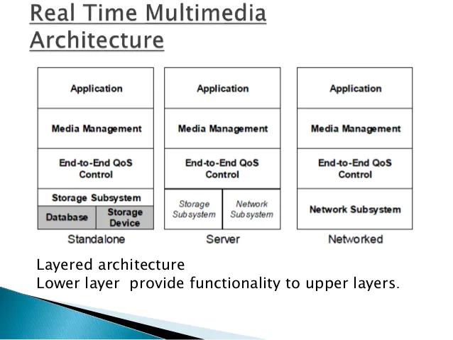

Slide 35
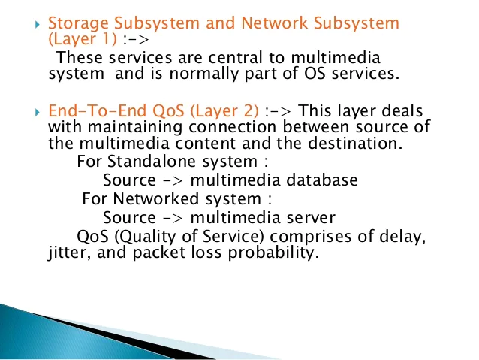

Slide 36
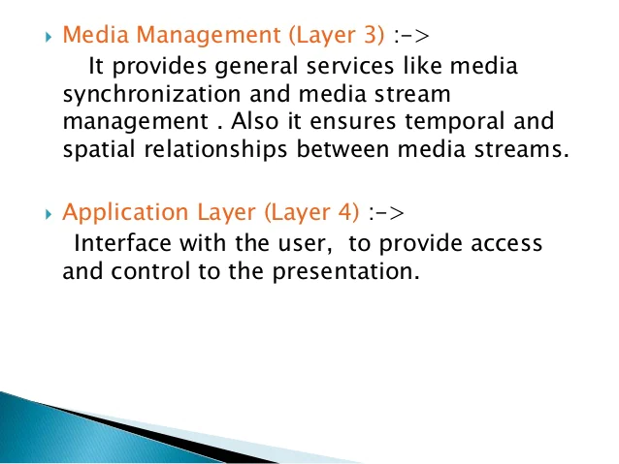

Slide 37
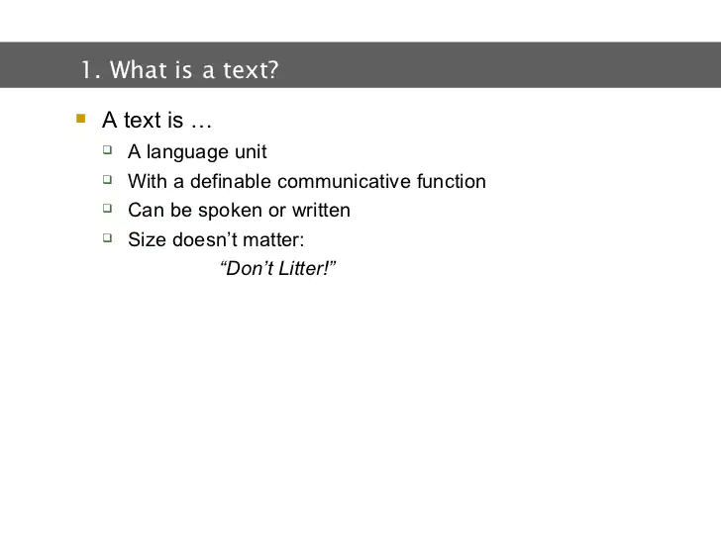

Slide 38
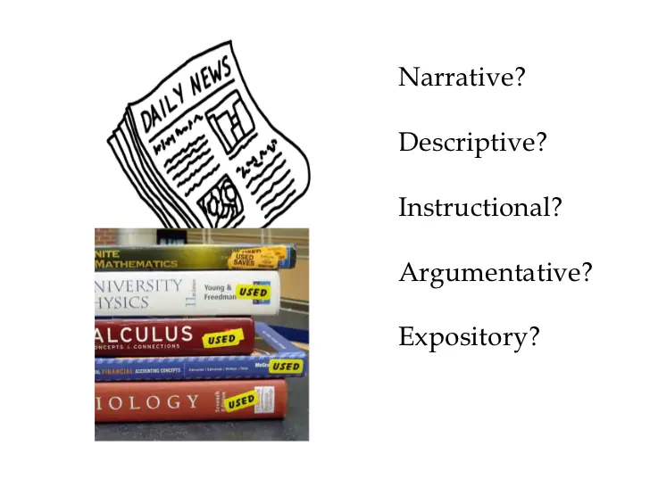
Types of text

Slide 39
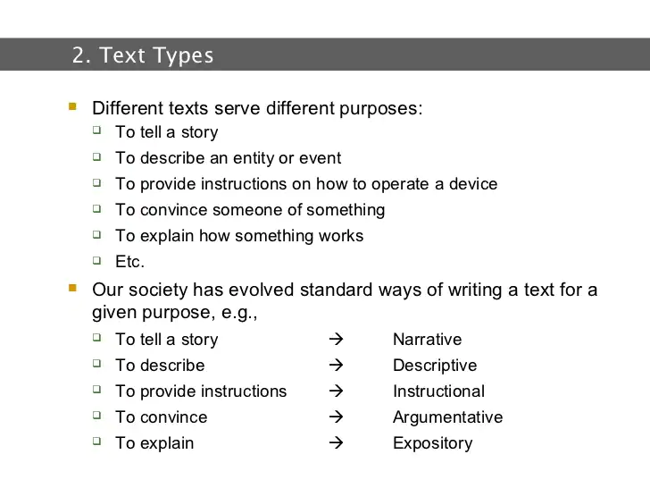
Types of text

Slide 40
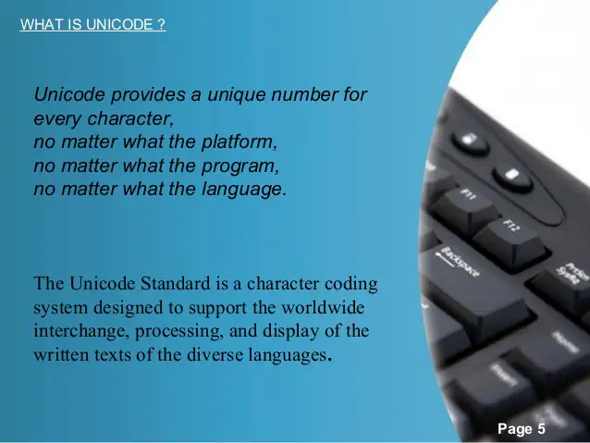
Unicode standards

Slide 41
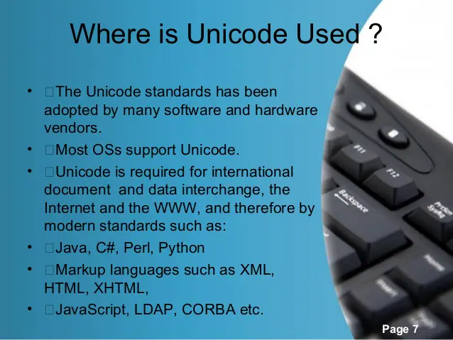

Slide 42
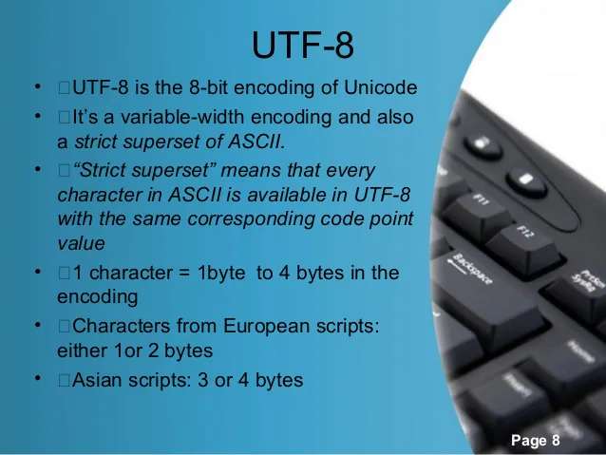

Slide 43
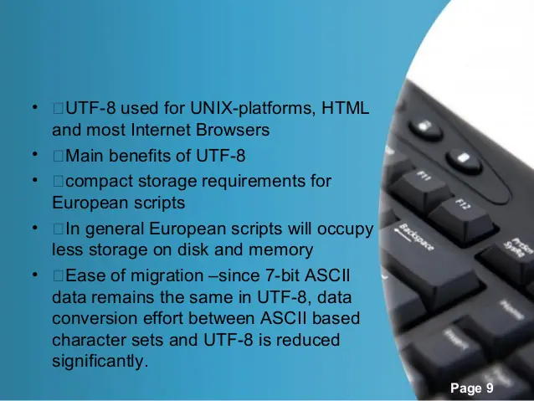
Unicode standards

Slide 44
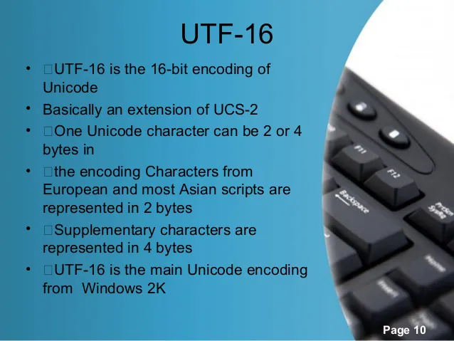
Unicode standards

Slide 45
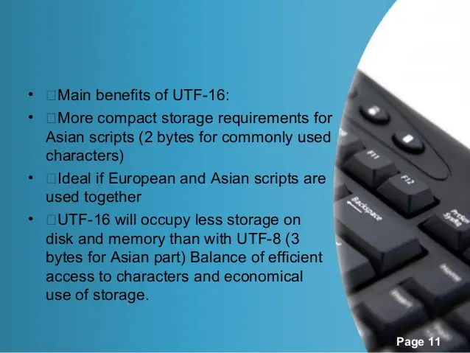
Unicode standards

Slide 46
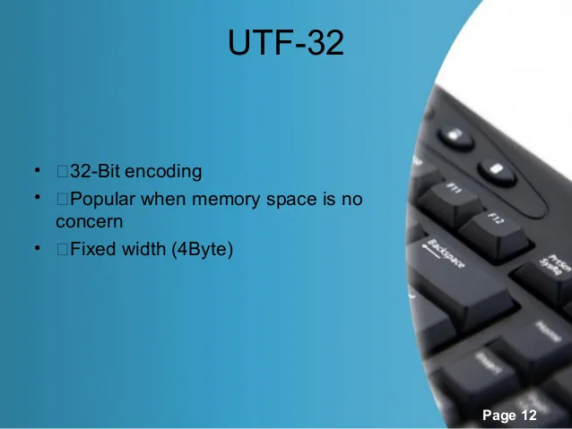
Unicode standards

Slide 47
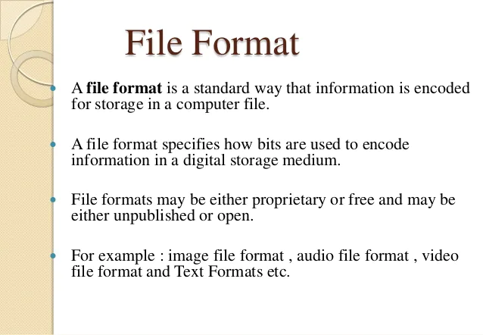
Text File Formats,

Slide 48
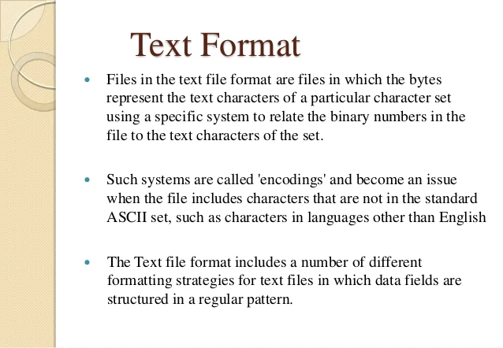
Text File Formats,

Slide 49
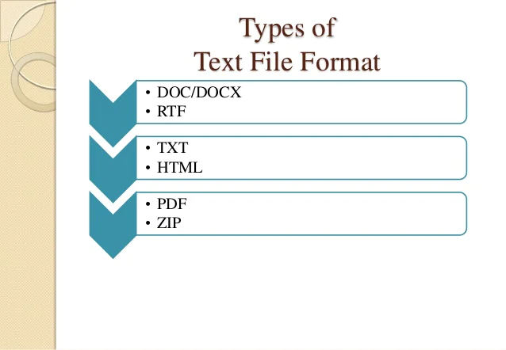
Text File Formats,

Slide 50
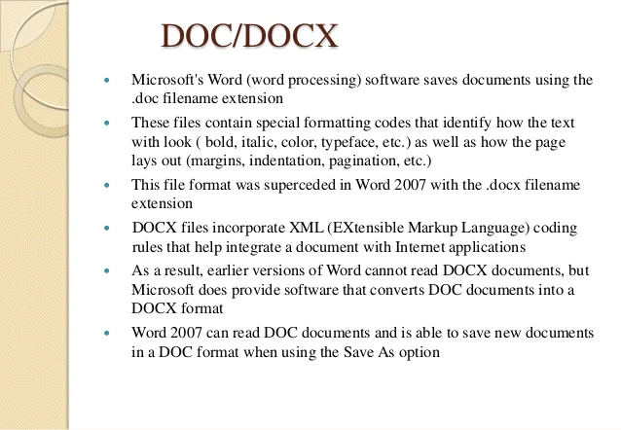
Text File Formats,

Slide 51
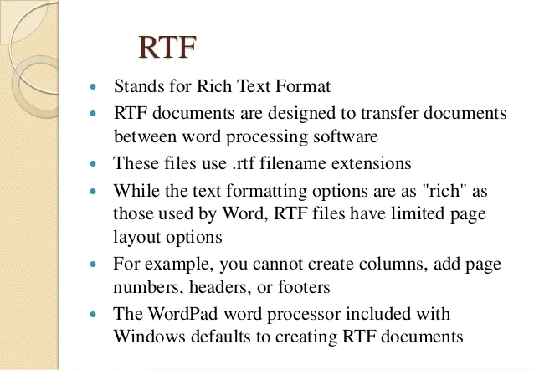
Text File Formats,

Slide 52
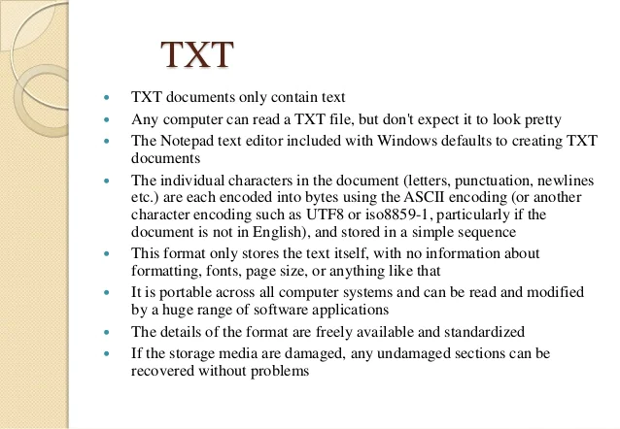
Text File Formats,

Slide 53
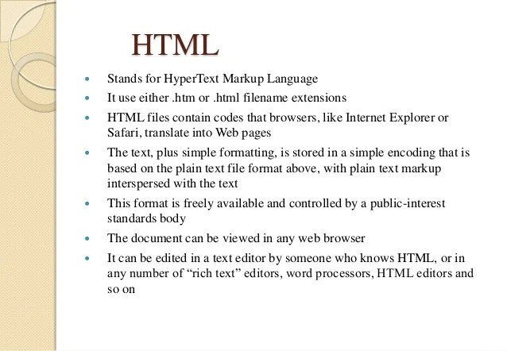
Text File Formats,

Slide 54

Text File Formats,

Slide 55

Text File Formats,

Slide 56

audio
Audio is a term used to describe any sound or noise in a range the human ear is capable of hearing. Measured in hertz, the audio signal on a computer is generated using a sound card and heard through speakers or headphones.

Slide 57
audio
Any digital information with speech or music stored on and played through a computer is known as an audio file or sound file. One of the most common types of audio file formats used today is the MP3. Clicking the triangular button on the following embedded player plays a short MP3 file in your browser.

Slide 58

Components of audio system

Slide 59
Components of audio system
The player reads the sound source stored on recording media
The amplifier amplifies the signals read by the player
The speaker converts the audio signals to actual sound

Slide 60


Slide 61


Slide 62


Slide 63


Slide 64


Slide 65


Slide 66


Slide 67


Slide 68


Slide 69


Slide 70

video
The term video refers to the moving picture, accompanied by sound such as a picture in television. Video element of multimedia application gives a lot of information in small duration of time. Digital video is useful in multimedia application for showing real life objects. Video have highest performance demand on the computer memory and on the bandwidth if placed on the internet. Digital video files can be stored like any other files in the computer and the quality of the video can still be maintained. The digital video files can be transferred within a computer network. The digital video clips can be edited easily.

Slide 71

Video in Multimedia
Digital Video:
Moving images that have been captured or created electronically by a computer

Slide 72


Slide 73


Slide 74


Slide 75


Slide 76


Slide 77


Slide 78


Slide 79


Slide 80


Slide 81


Slide 82


Slide 83
animation
Animation is the process of designing, drawing, making layouts and preparation of photographic sequences which are integrated in the multimedia and gaming products. Animation involves the exploitation and management of still images to generate the illusion of movement. A person who creates animations is called animator. He / she use various computer technologies to capture the still images and then to animate these in desired sequence.

Slide 84

Uses of animation
Education
As we all know that people used to remember pictures or images more than text, So Animation is the only and the best way to understand the main motive of any education and it helps everyone to growth in their practical life. Animation is used in education because it makes children watch the animation and not get bored with it allowing them to intake information.

Slide 85

Uses of animation
Animation is used on the TV, on your phones, and all over the internet. In television, animation is mostly used to occupy children, as is gives them something to laugh about and keep them entertained for long periods of time. Programs such as Tom and Jerry are created to make the children laugh, and tell the audience that just because you are bigger than someone else, doesn’t make you better.

Slide 86

Uses of animation
Advertisement
Animation plays a big part in advertisement. Many big companies use animation in some kind of way to attract the audience. An example of animation in advertising is the Dancing Pony Advert by the phone company ‘Three’. This advert attracted millions of people all over the world to their website and in return they gained a massive profit. Animation is also used for advertisement on the web. Many games companies create cool looking animations to attract the audience to play the game or visit the website.

Slide 87

Uses of animation
Scientific visualization
Animation is used to create models that are essential for research and study. Animation allows you to create 3D, realistic models that allow diagrams etc. to show accurate representations of an object. An example of this is an X-ray. Doctors use this to get an accurate look at bones etc. so that problems can be fixed quicker and more efficiently.

Slide 88

Uses of animation
Creative Arts
Animation is also used in creative arts to show and produce the skills needed to achieve a grade for example an IT course is creative arts, which is a specified skill in creativity. They would use animation in their work and much of it for presenting to the class they would use various diagrams and animations to get a topic across the class in presentations

Slide 89

Uses of animation
Gaming
In gaming Industries most of the things depends on animation. Without model a programmer can’t programmer a game and everything in the scene starting from modeling, Texturing, Rigging, lighting etc. all are done by the Animation students or professionals.

Slide 90

Uses of animation
Simulations
Simulations are mostly used in the military for weapons training and to train for certain events. Pilots also use simulations to practice their flight training without having to spend money on fuel and equipment. Simulations are also used for practicing events and to get a predicted outcome for something. For example, when NASA are planning on putting a rocket in space, they will use simulations to get a predicted outcome of what might happen. This is essential because it can potentially save lives and resources.

Slide 91

Principles of Animation

Slide 92


Slide 93


Slide 94


Slide 95


Slide 96


Slide 97


Slide 98


Slide 99


Slide 100


Slide 101


Slide 102


Slide 103


Slide 104


Slide 105


Slide 106


Slide 107


Slide 108


Slide 109


Slide 110


Slide 111


Slide 112
3 D animation
3D animation is the art of using motion to bring characters, vehicles, props, and more to life within TV shows, films, and games.
3D animation uses computer graphics to make objects look like they are moving in 3-dimensional space.

Slide 113


Slide 114


Slide 115


Slide 116


Slide 117
Animation file formats
MP4: is a file format created by the Moving Picture Experts Group (MPEG) as a multimedia container format designed to store audiovisual data.
MOV: is a multimedia container file format developed by Apple and compatible with both Macintosh and Windows platforms. It can contain multiple tracks that store different types of media data and is often used for saving movies and other video files.

Slide 118
Animation file formats
GIF: is an image encoded in Graphics Interchange Format (GIF) which contains a number of images or frames in a single file and is described by its own graphic control extension. The frames are presented in a specific order in order to convey animation. An animated GIF can loop endlessly or stop after a few sequences.
Adobe After Effects: is a digital visual effects, motion graphics, and compositing application developed by Adobe Systems and used in the post-production process of film making and television production.It can be used for keying, tracking, compositing and animation.

Slide 119
Animation file formats
CSS (Cascading Style Sheets): make it possible to animate transitions from one CSS style configuration to another. We use these a lot in our Headless CMS websites. Essentially CSS animations consist of two components: a style describing the CSS animation and a set of keyframes that indicate the start and end states of the animation’s style, as well as possible intermediate waypoints.

Slide 120
Animation software
Animaker
Platforms: web browser-based
Animaker is a free animation software for beginners, with easy drag-and-drop functionality and an intuitive interface to match. There are six core types of videos you can make with Animaker:
2D
Infographics
Handcraft
Whiteboard
2.5D
Typography

Slide 121
Animation software
Blender
Platforms: Windows, Mac, Linux
Use Blender if you’re looking for the best video animation software for pro editors and creators. The free open-source 3D animation tool supports the “modeling, rigging, animation, simulation, rendering, compositing and motion tracking, video editing, and 2D animation pipeline.” The platform is a public project, and creatives from all over the world contribute to its ongoing maintenance.

Slide 122
Animation software
K-3D
Platforms: Windows, Linux
K-3D is a free 3D animation software specializing in polygonal modeling, an approach to digital graphics that represents and approximates object surfaces using polygons. Designed for artists, the software combines plugins with a visualization pipeline architecture — it adapts to the look and feel of the tools you integrate it with.

Slide 123
Animation software
OpenToonz
Platforms: Windows, Mac, and Linux
OpenToonz is one of the top free animation software for 2D videos. The open-source software is free for both commercial and non-commercial use, so you can use it to create marketing videos for your brand.

Slide 124
Animation software
Pencil2D Animation
Platforms: Windows, Mac, and Linux
Pencil2D is a simple animation software you can use to create hand-drawn 2D videos. The open-source software is free for both personal and commercial use, so you can use it just for fun or to create videos to promote your products.
The interface is simple and easy to use. That, along with tons of tutorials on the website and forums you can join, makes it a great option to start with.

Slide 125
Animation software
Plastic Animation Paper
Platforms: Windows, Mac, and Linux
Plastic Animation Paper (PAP) is a free animation software for PC, Mac, and Linux. Though its interface is outdated, the software is completely free to download and use. Beggars can’t be choosers, right?

Slide 126
Animation software
Powtoon
Platforms: web browser-based
The next video animation software that’s free is Powtoon, meant for dynamic video presentations. While there are paid options with advanced features, Powtoon also has a stripped-down free tool for videos up to three minutes long.

Slide 127
Animation software
Stykz
Platforms: Windows, Mac, and Linux
Stykz is one of the easiest animation software to use. With it, you can make basic 2D stick figure animated videos,

Slide 128
Animation software
Synfig Studio
Platforms: Windows, Mac, and Linux
The next free video animation online is Synfig Studio, an open-source platform for creating 2D animated videos. With it, you use vector graphics to create timeline-based animations.

Slide 129
Animation software
Toontastic 3D
Platforms: Android, iOS
Google’s own free animation software for Android, Toontastic 3D is meant for kids, but brands can also use it to make animated 3D videos. Ideal for storytelling, you get started with Toontastic by creating your own characters, either from scratch or based off an uploaded photo. Then it’s time to insert your characters into a story.

Slide 130
Mpeg standards
The MPEG standards are an evolving set of standards for video and audio compression and for multimedia delivery developed by the Moving Picture Experts Group (MPEG).
MPEG-1 was designed for coding progressive video at a transmission rate of about 1.5 million bits per second. It was designed specifically for Video-CD and CD-i media. MPEG-1 audio layer-3 (MP3) has also evolved from early MPEG work.
MPEG-2 was designed for coding interlaced images at transmission rates above 4 million bits per second. MPEG-2 is used for digital TV broadcast and DVD. An MPEG-2 player can handle MPEG-1 data as well.

Slide 131
Mpeg standards
MPEG-1 and -2 define techniques for compressing digital video by factors varying from 25:1 to 50:1. The compression is achieved using five different compression techniques:
The use of a frequency-based transform called Discrete Cosine Transform (DCT).
Quantization, a technique for losing selective information (sometimes known as lossy compression) that can be acceptably lost from visual information.
Huffman coding, a technique of lossless compression that uses code tables based on statistics about the encoded data.
Motion compensated predictive coding, in which the differences in what has changed between an image and its preceding image are calculated and only the differences are encoded.
Bi-directional prediction, in which some images are predicted from the pictures immediately preceding and following the image.

Slide 132
Mpeg standards
A proposed MPEG-3 standard, intended for High Definition TV (HDTV), was merged with the MPEG-2 standard when it became apparent that the MPEG-2 standard met the HDTV requirements.
MPEG-4 is a much more ambitious standard and addresses speech and video synthesis, fractal geometry, computer visualization, and an artificial intelligence (AI) approach to reconstructing images. MPEG-4 addresses a standard way for authors to create and define the media objects in a multimedia presentation, how these can be synchronized and related to each other in transmission, and how users are to be able to interact with the media objects.

Slide 133
Mpeg standards
MPEG-21 provides a larger, architectural framework for the creation and delivery of multimedia. It defines seven key elements:
Digital item declaration
Digital item identification and declaration
Content handling and usage
Intellectual property management and protection
Terminals and networks
Content representation
Event reporting

Slide 134
THANK YOU

